Slide 1


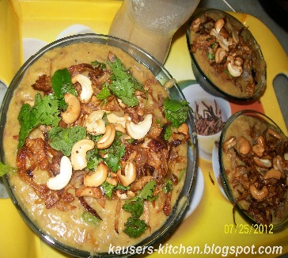
Capstone Project - The Competing Neighborhoods (Week 5)
Recommendation to Open New Indian Hyderabadi Restaurant in New York
Indian Hyderabadi Restaurant
in New York

Slide 2
Table of contents
I Introduction: Business Problem
II Data/Dataset
III Methodology
IV Analysis
V Results and Discussion
VI Conclusion

Slide 3
I Introduction: Business Problem
In this capstone project a new restaurant's suitable/profitable/optimal location will be found. Particularly, the stakeholders are interested in Indian Hyderabdi restaurant in New York, USA. There are so many restaurants in New York we will choose such a place/location where there are less restaurants.
Also, we also needs to choose such a location where there are no Indian Hyderabadi restaurants nearby. Furthermore, we also take care that the prefer places/locations should be as close as possible to the city center, along with the first two criteria are met.
We will recommend the most suitable palces/neighborhoods based above mentioned criteria using the skills we learn during this long journey of Data Science Course. So stakeholders can choose best, suitable, possible area/location as we explain pros and cons each location in clear and easy way.

Slide 4
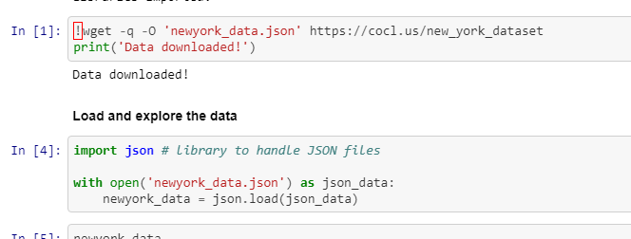
II Data/Dataset
As we defined our problem and based on this, Our deicsion is influenced by following criteria/factors:
The number of already existing restaurants(can be of any type) in the area/neighborhood
If any, how many number of and far to Hyderabadi restaurants.
From the heart of the city, the neighborhood is how much far away

Slide 5
II Data/Dataset
To define our neighborhood/area, we will use regularly spaced grid of locations, centered aoround heart of the city.
To extract/generate the required information, below data sources will be required:
Foursquare API to get venue data related to these neighborhoods, number of restaurants & their type and location in every area/neighborhood will be obtained
To solve this problem, we will need below data:
List of neighborhoods in New York, USA
Latitude and Longitude of these neighborhoods
Venue data related to Indian Hyderabadi restaurants. This will help us find neighborhoods that are more suitable to open an Indian Hyderabadi Restaurant.

Slide 6
EXTRACTING THE DATA
The scrapping of New York neighborhoods via Wikipedia
Getting Latitude and Longitude data of these neighborhoods via Geocoder package
Neighborhood Candidates
For centroids of our candidate neighborhoods, let's create latitude and longitude coordinates. Around the heart of the New York City, we will create a grid of cells covering our area of interest which is approximately 11x11 kilometers.
Using specific, well known address and Google Maps geocoding API, let's first find the latitude & longitude of heart of the New York City.

Slide 7
III Methodology
First, I need to get the list of neighborhoods in New York, USA. This is possible by extracting the list of neighborhoods from url already available in one of the labs in this course. I did the web scraping by utilizing pandas HTML table scraping method as it is easier and more convenient to pull tabular data directly from a web page into the data frame.
However, it is only a list of neighborhood names and postal codes. I need to get their coordinates to utilize Foursquare to pull the list of venues near these neighborhoods. To get the coordinates, I tried using Geocoder Package but it was not working so I used the CSV file provided by IBM team to match the coordinates of New York neighborhoods.

Slide 8
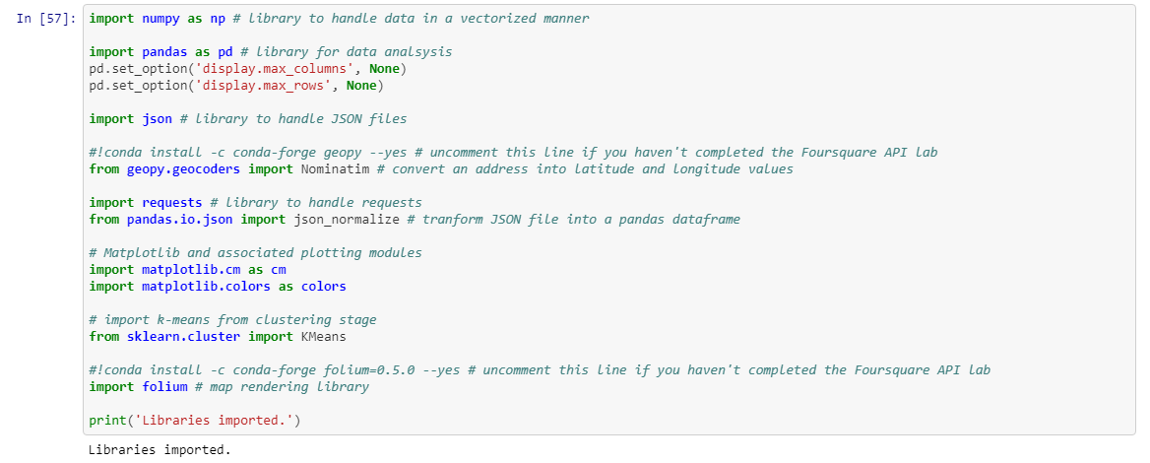
III Methodology

Slide 9
III Methodology
After gathering these coordinates, I visualize the map of New York using Folium package to verify whether these are correct coordinates. Next, I use Foursquare API to pull the list of top 100 venues within 500 meters radius.
I have created a Foursquare developer account in order to obtain account ID and API key to pull the data. From Foursquare, I am able to pull the names, categories, latitude, and longitude of the venues. With this data, I can also check how many unique categories that I can get from these venues.
Then, I analyze each neighborhood by grouping the rows by neighborhood and taking the mean on the frequency of occurrence of each venue category. This is to prepare clustering to be done later. Here, I made a justification to specifically look for “Indian restaurants”.

Slide 10
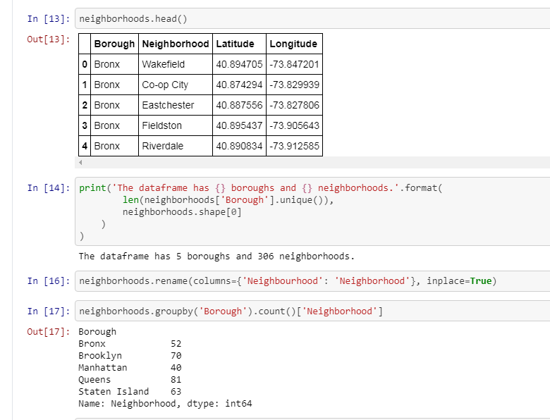
III Methodology

Slide 11
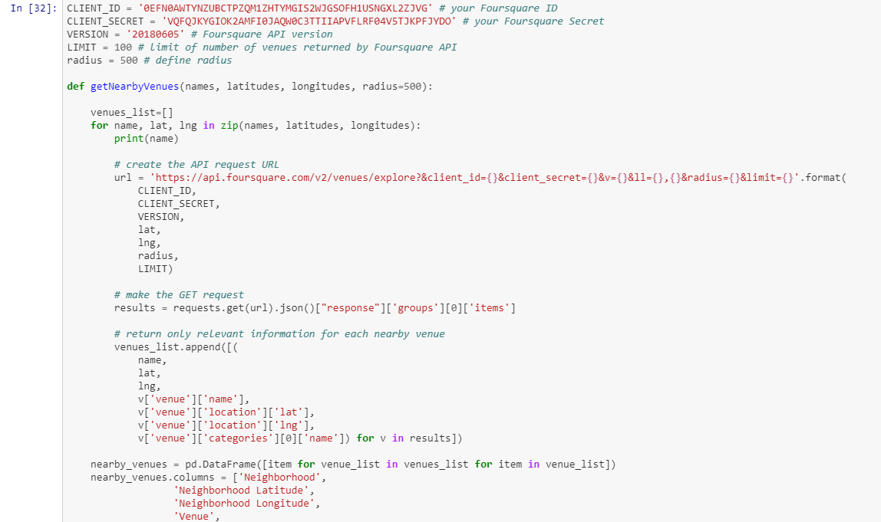
III Methodology

Slide 12
III Methodology
Lastly, I performed the clustering method by using k-means clustering. K-means clustering algorithm identifies k number of centroids, and then allocates every data point to the nearest cluster while keeping the centroids as small as possible.
It is one of the simplest and popular unsupervised machine learning algorithms and it is highly suited for this project as well.

Slide 13
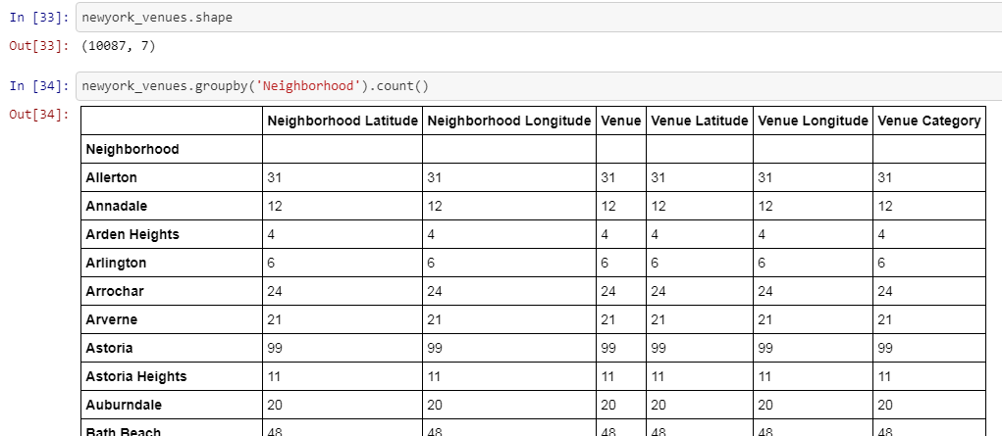
IV Analysis

Slide 14
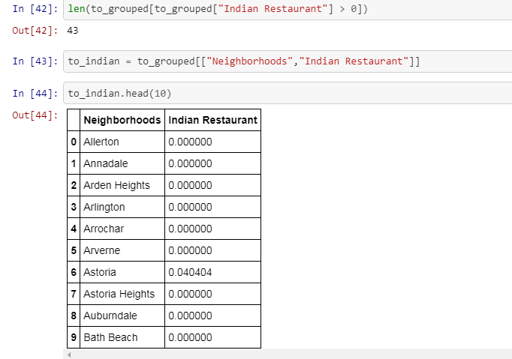
IV Analysis

Slide 15
IV Analysis
I have clustered the neighborhoods in New York into 3 clusters based on their frequency of occurrence for “Indian food”.
Based on the results (the concentration of clusters), I will be able to recommend the ideal location to open the restaurant.

Slide 16
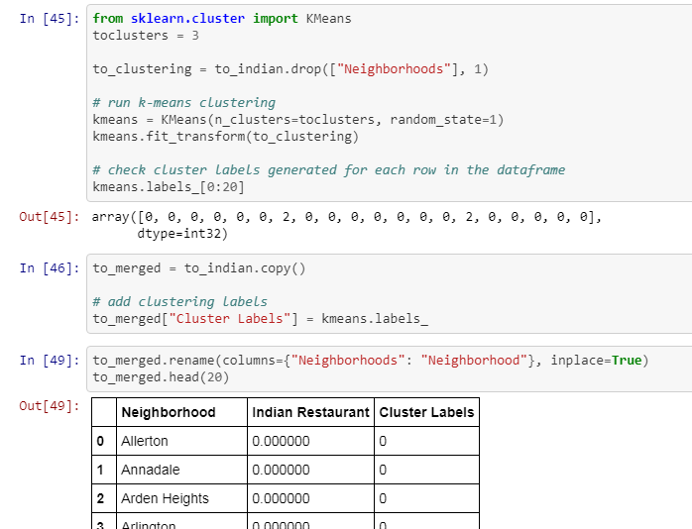
V Results and Discussion

Slide 17
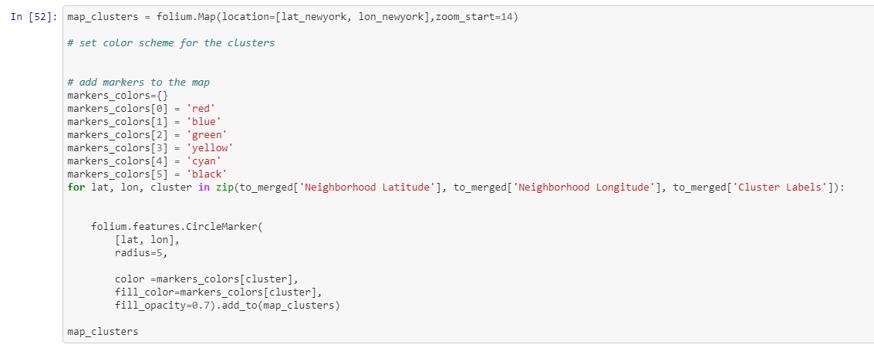
V Results and Discussion

Slide 18
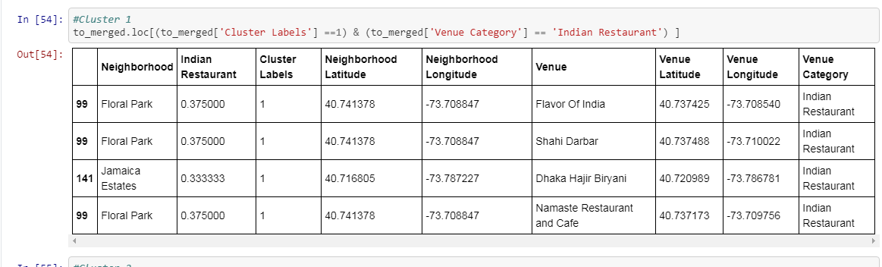
V Results and Discussion

Slide 19
VI Conclusion
Most of the Indian restaurants are in cluster 2 which is around Bayside, Astoria, Greenwich Village.
And lowest in cluster 0 and 3 areas which are in midtown, noho, and north side areas. Also, there are good opportunities to open new "Indian Hyderabad restaurant" in this area.
So stakeholders can choose this area.

Slide 20
Thank you for review

